Slide 1



SPELLING NAMES

Slide 2

How do you spell your name?
Click here
L A U R A
L A Y L A
L A R I A
NEXT

Slide 3
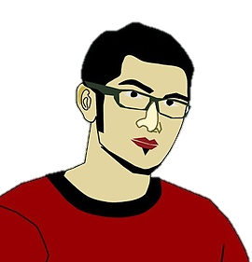
How do you spell your name?
Click here
P A U L
P E R C Y
P E T E R
NEXT

Slide 4

How do you spell your name?
Click here
M A D G E
M A B E L
M A R T A
NEXT

Slide 5

How do you spell your name?
Click here
N A N C Y
N A D I A
N O R A H
NEXT

Slide 6

How do you spell your name?
Click here
T A M I R
T A R I K
T A N E R
NEXT

Slide 7

How do you spell your name?
Click here
S O N I A
S U S A N
S A R A H
NEXT

Slide 8
How do you spell your name?
Click here
W A L L Y
W A L I D
W A I N E
NEXT

Slide 9

How do you spell your name?
Click here
A B B I E
A B R I E
A D E L E
NEXT

Slide 10

How do you spell your name?
Click here
A K A K O
A Y A K O
A K E M I
NEXT

Slide 11
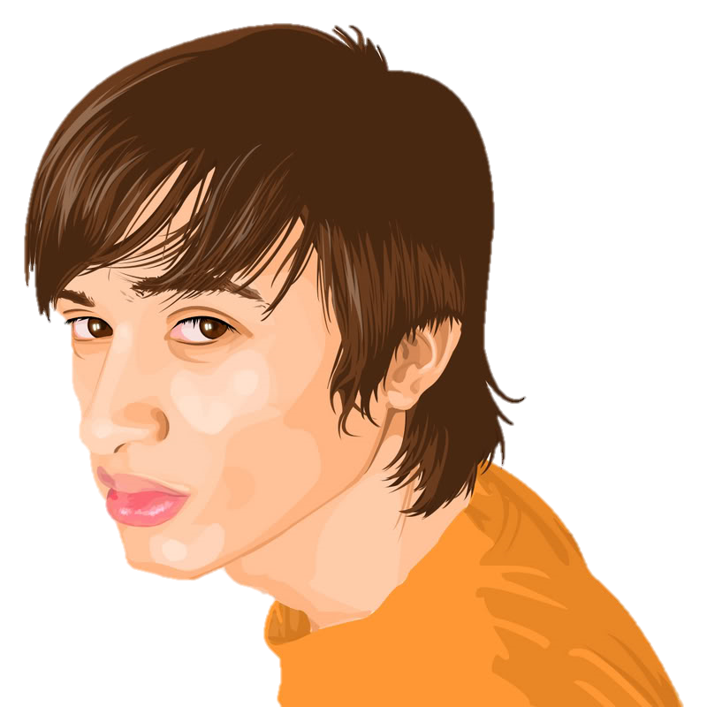
How do you spell your name?
Click here
K A C E Y
K A I N E
K A L E B
NEXT

Slide 12
HOW DO YOU SPELL YOUR NAME?

